Slide 1
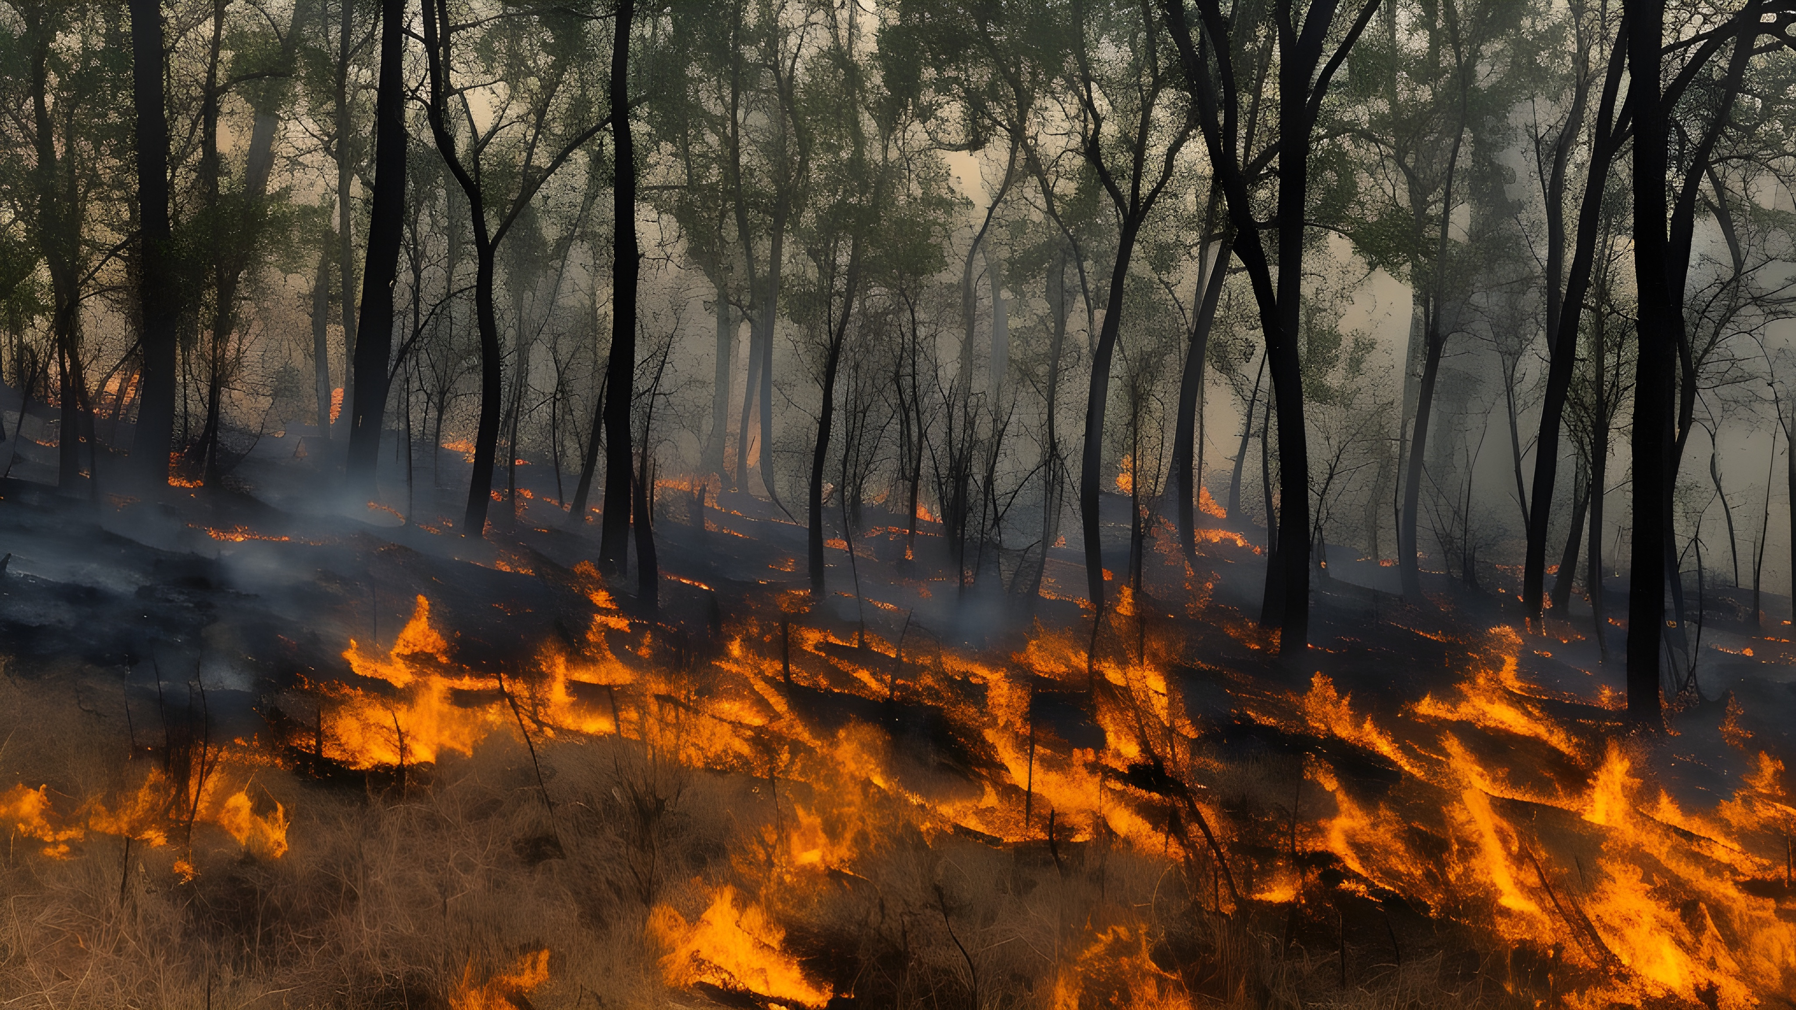
The impact of fire frequency on the root economic spectrum of herbaceous plants

Slide 2
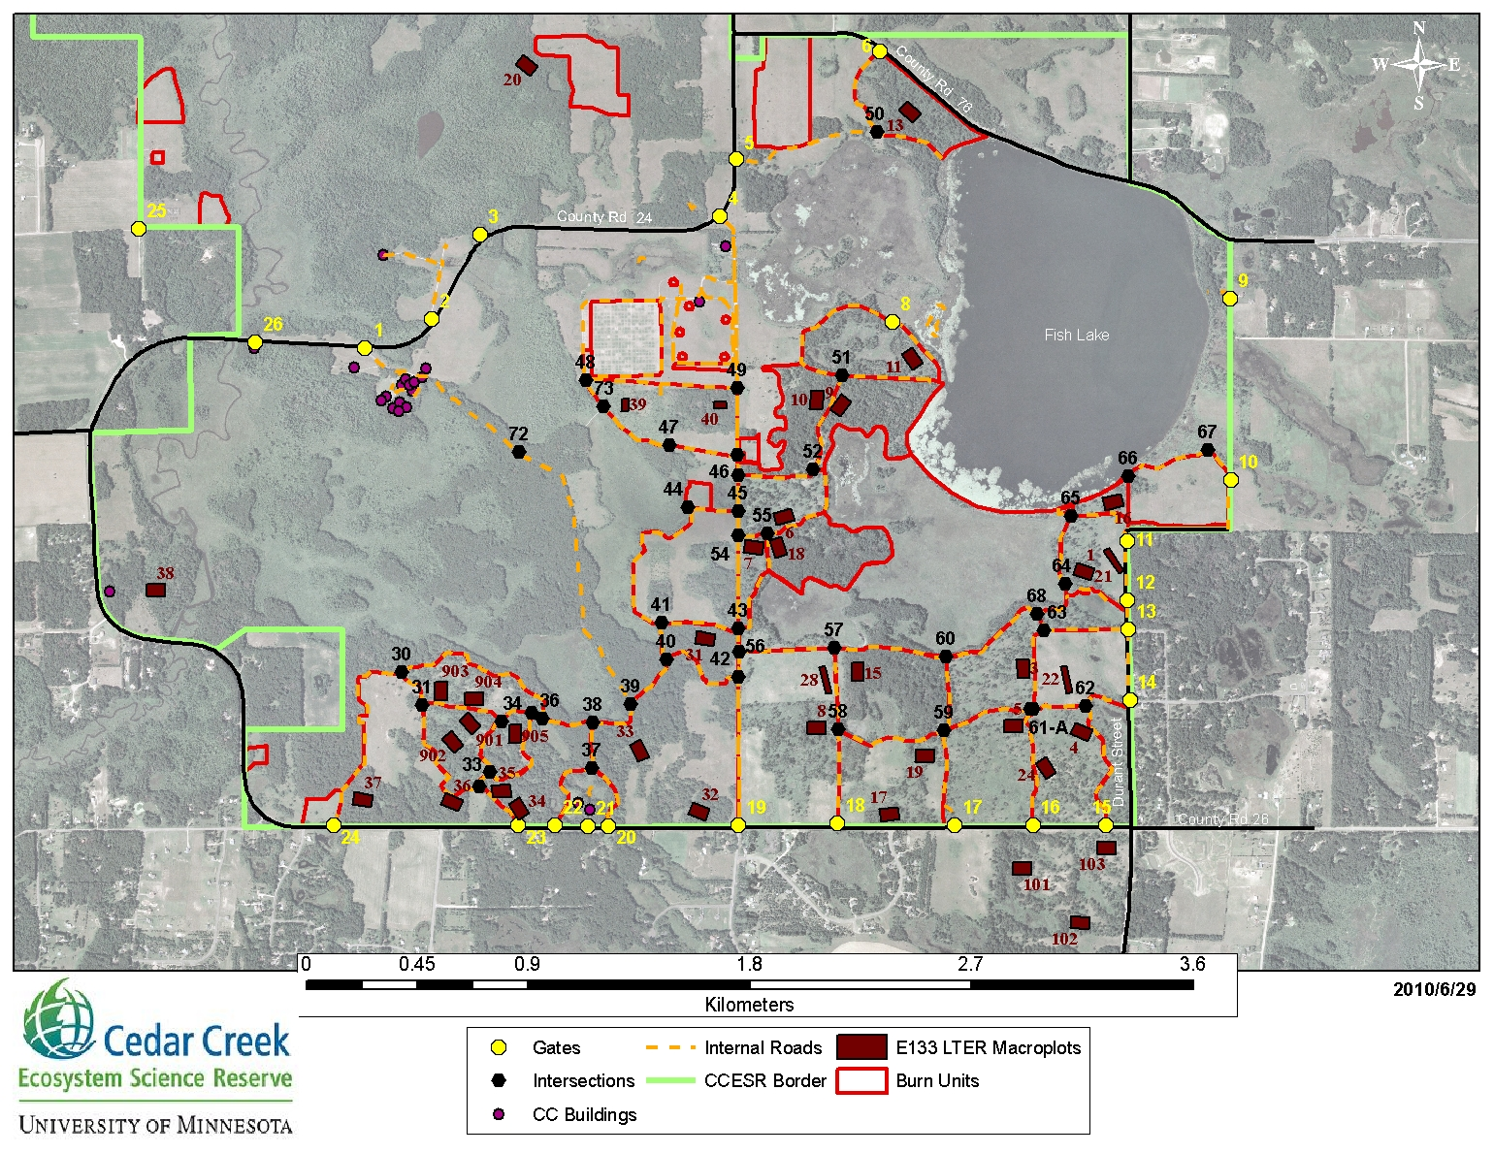
Background on the project
Understanding how plant species and communities optimise trade offs after disturbance events, belowground Cedar Creek Ecosystem Science Reserve - plots with different prescribed burn frequencies. How does fire frequency affect mycorrhizal colonisation in herbaceous plants?

Slide 3
Root traits background

Slide 4
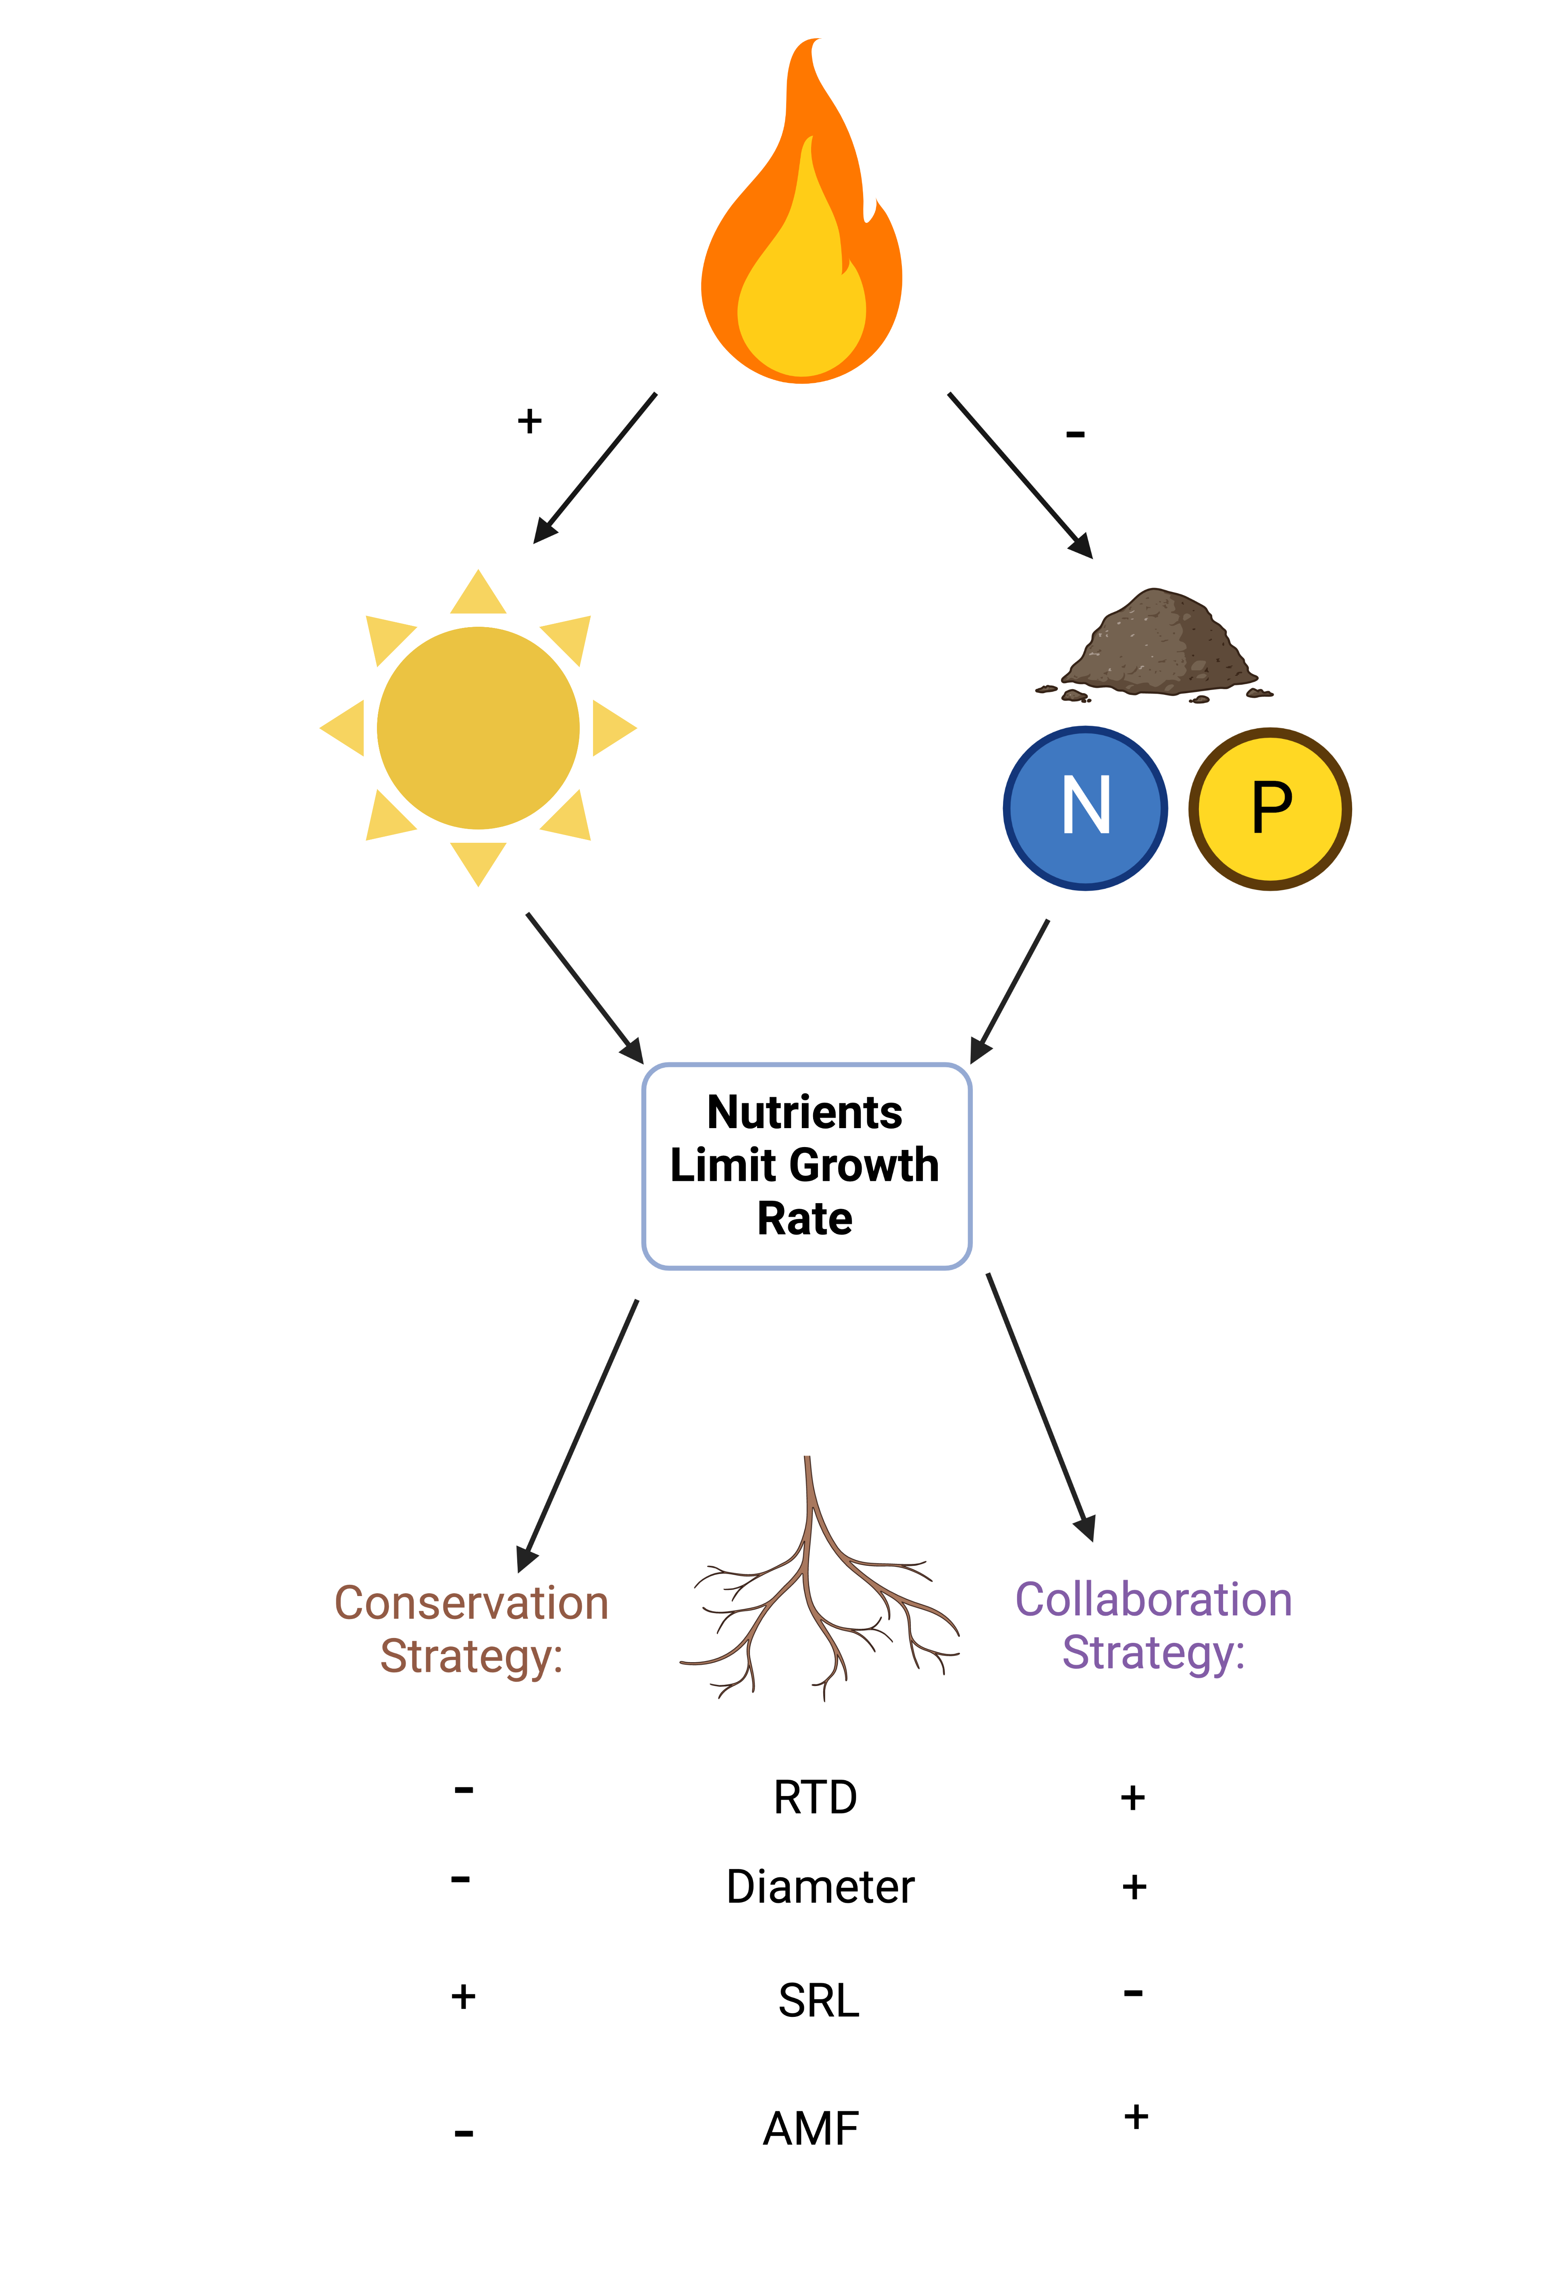
Graphical Abstract

Slide 5
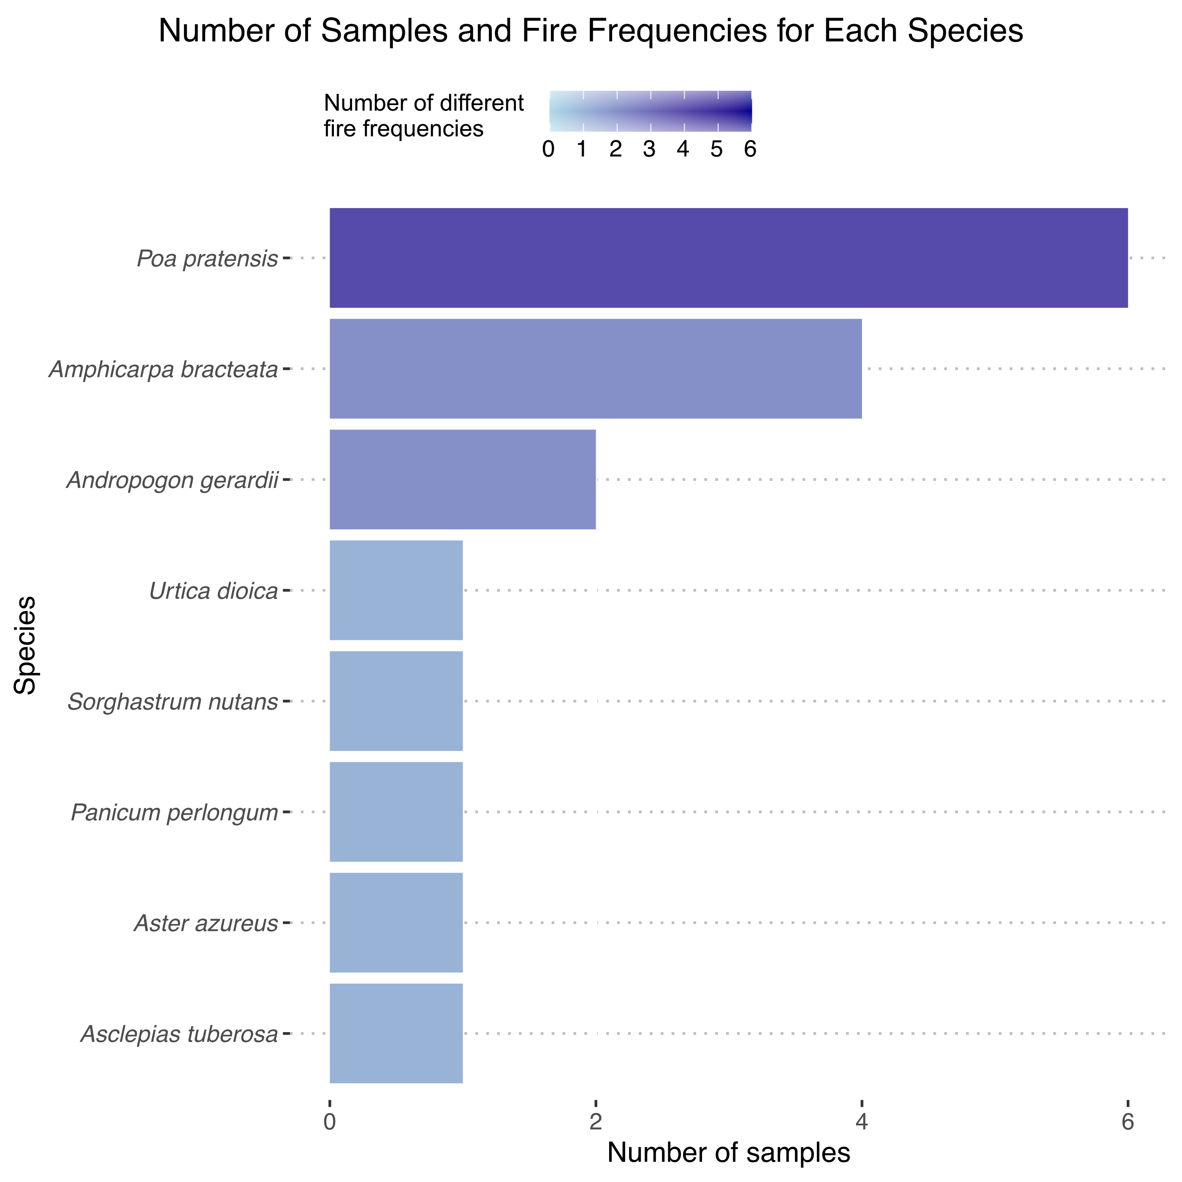
Methods – Experimental methods

Slide 6
Methods – Soil nutrient data
Basically just given the data

Slide 7

Methods – Root Architecture Data - Scanning
Notes:
Struggles: laptop kept crashing, roots too thick

Slide 8
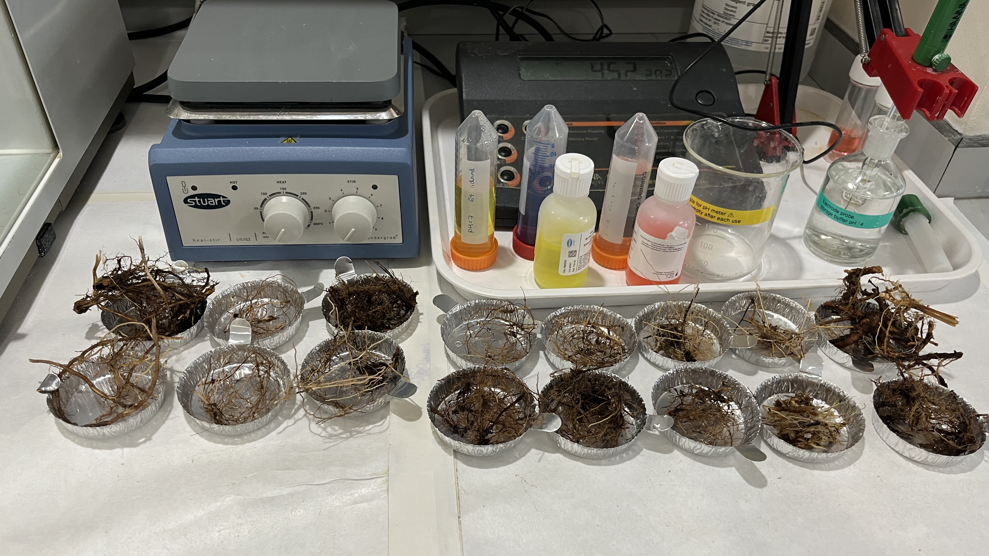
Methods – Root Architecture Data - Weighing

Slide 9
Methodological challenges – quantifying mycorrhizal colonisation

Slide 10
Staining

Slide 11
Mycorrhizal or pathogenic?

Slide 12
Spider Roots

Slide 13
Identifying a diverse range of AMF structures

Slide 14

Results

Slide 15
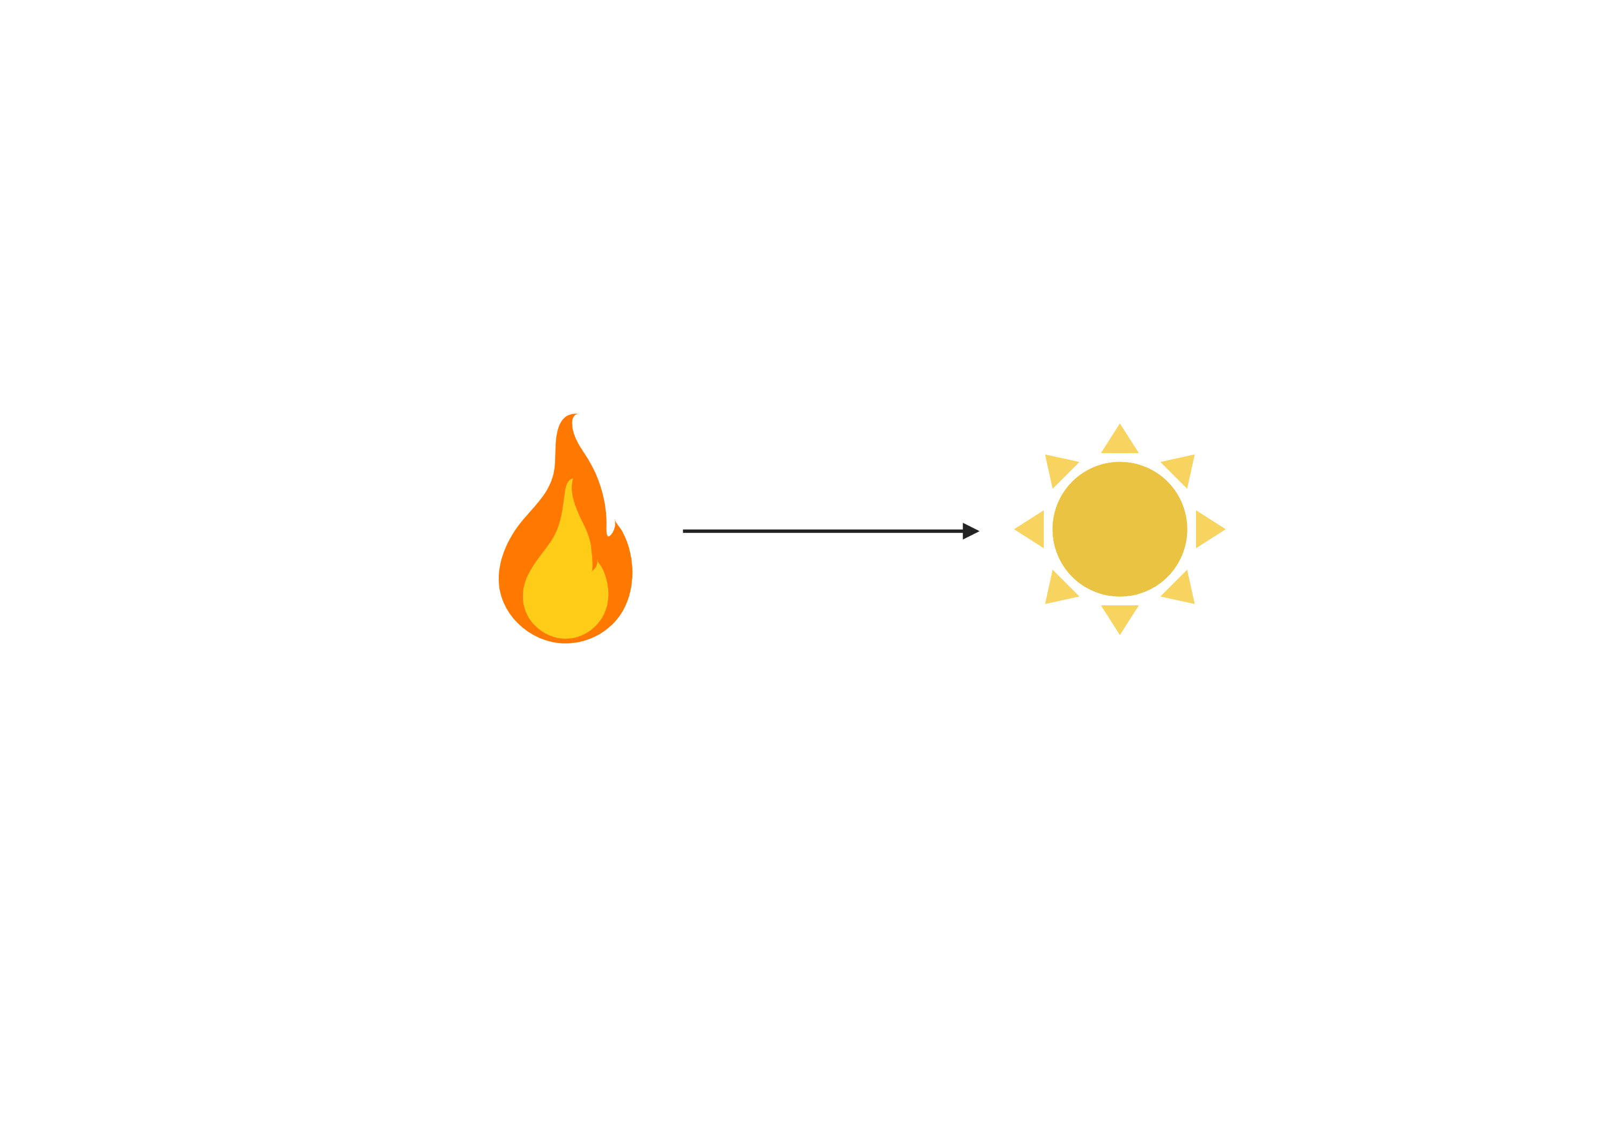
Positive correlation between fire frequency and light availability to herbs

Slide 16
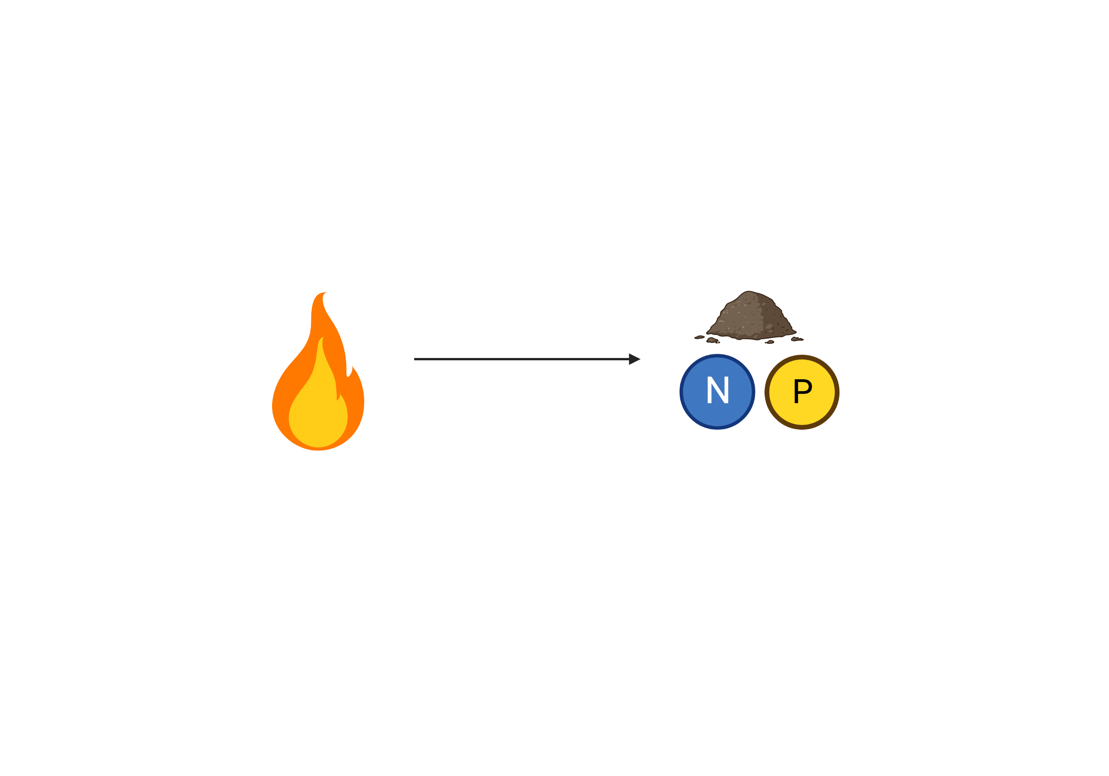
Increasing fire frequency is associated with decreased soil inorganic nitrogen

Slide 17
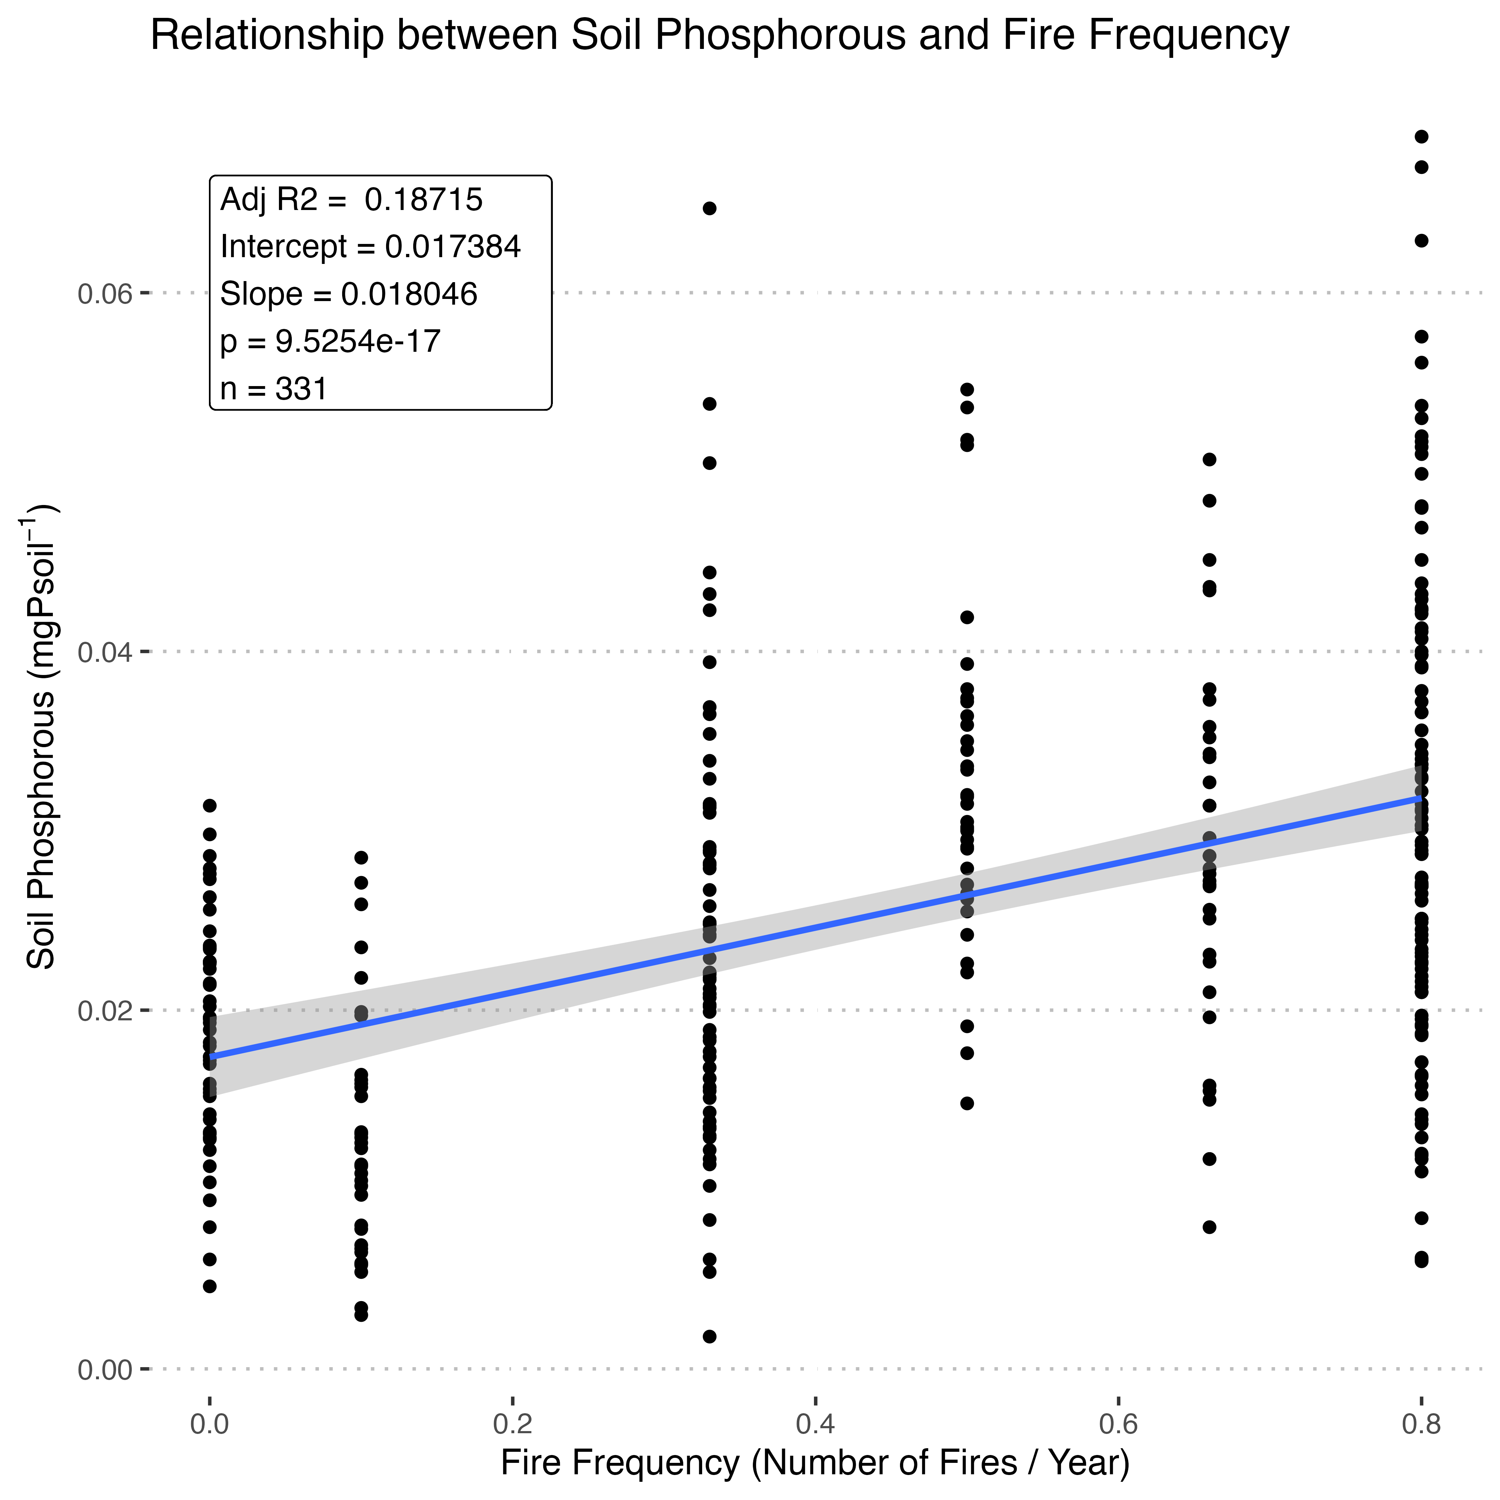
but increased phosphorous

Slide 18
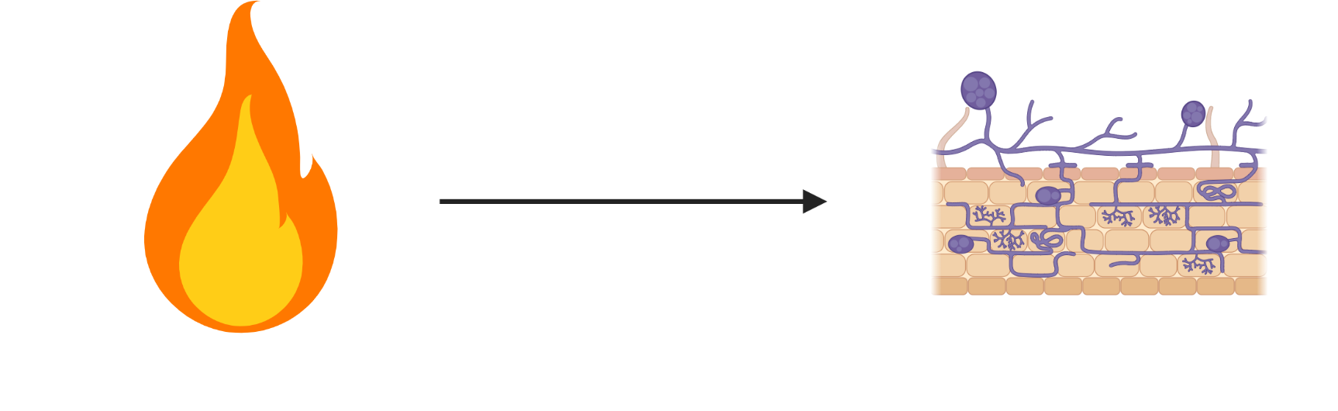
Non-legume forbs seem to be colonized less than other functional groups, but non-significant

Slide 19
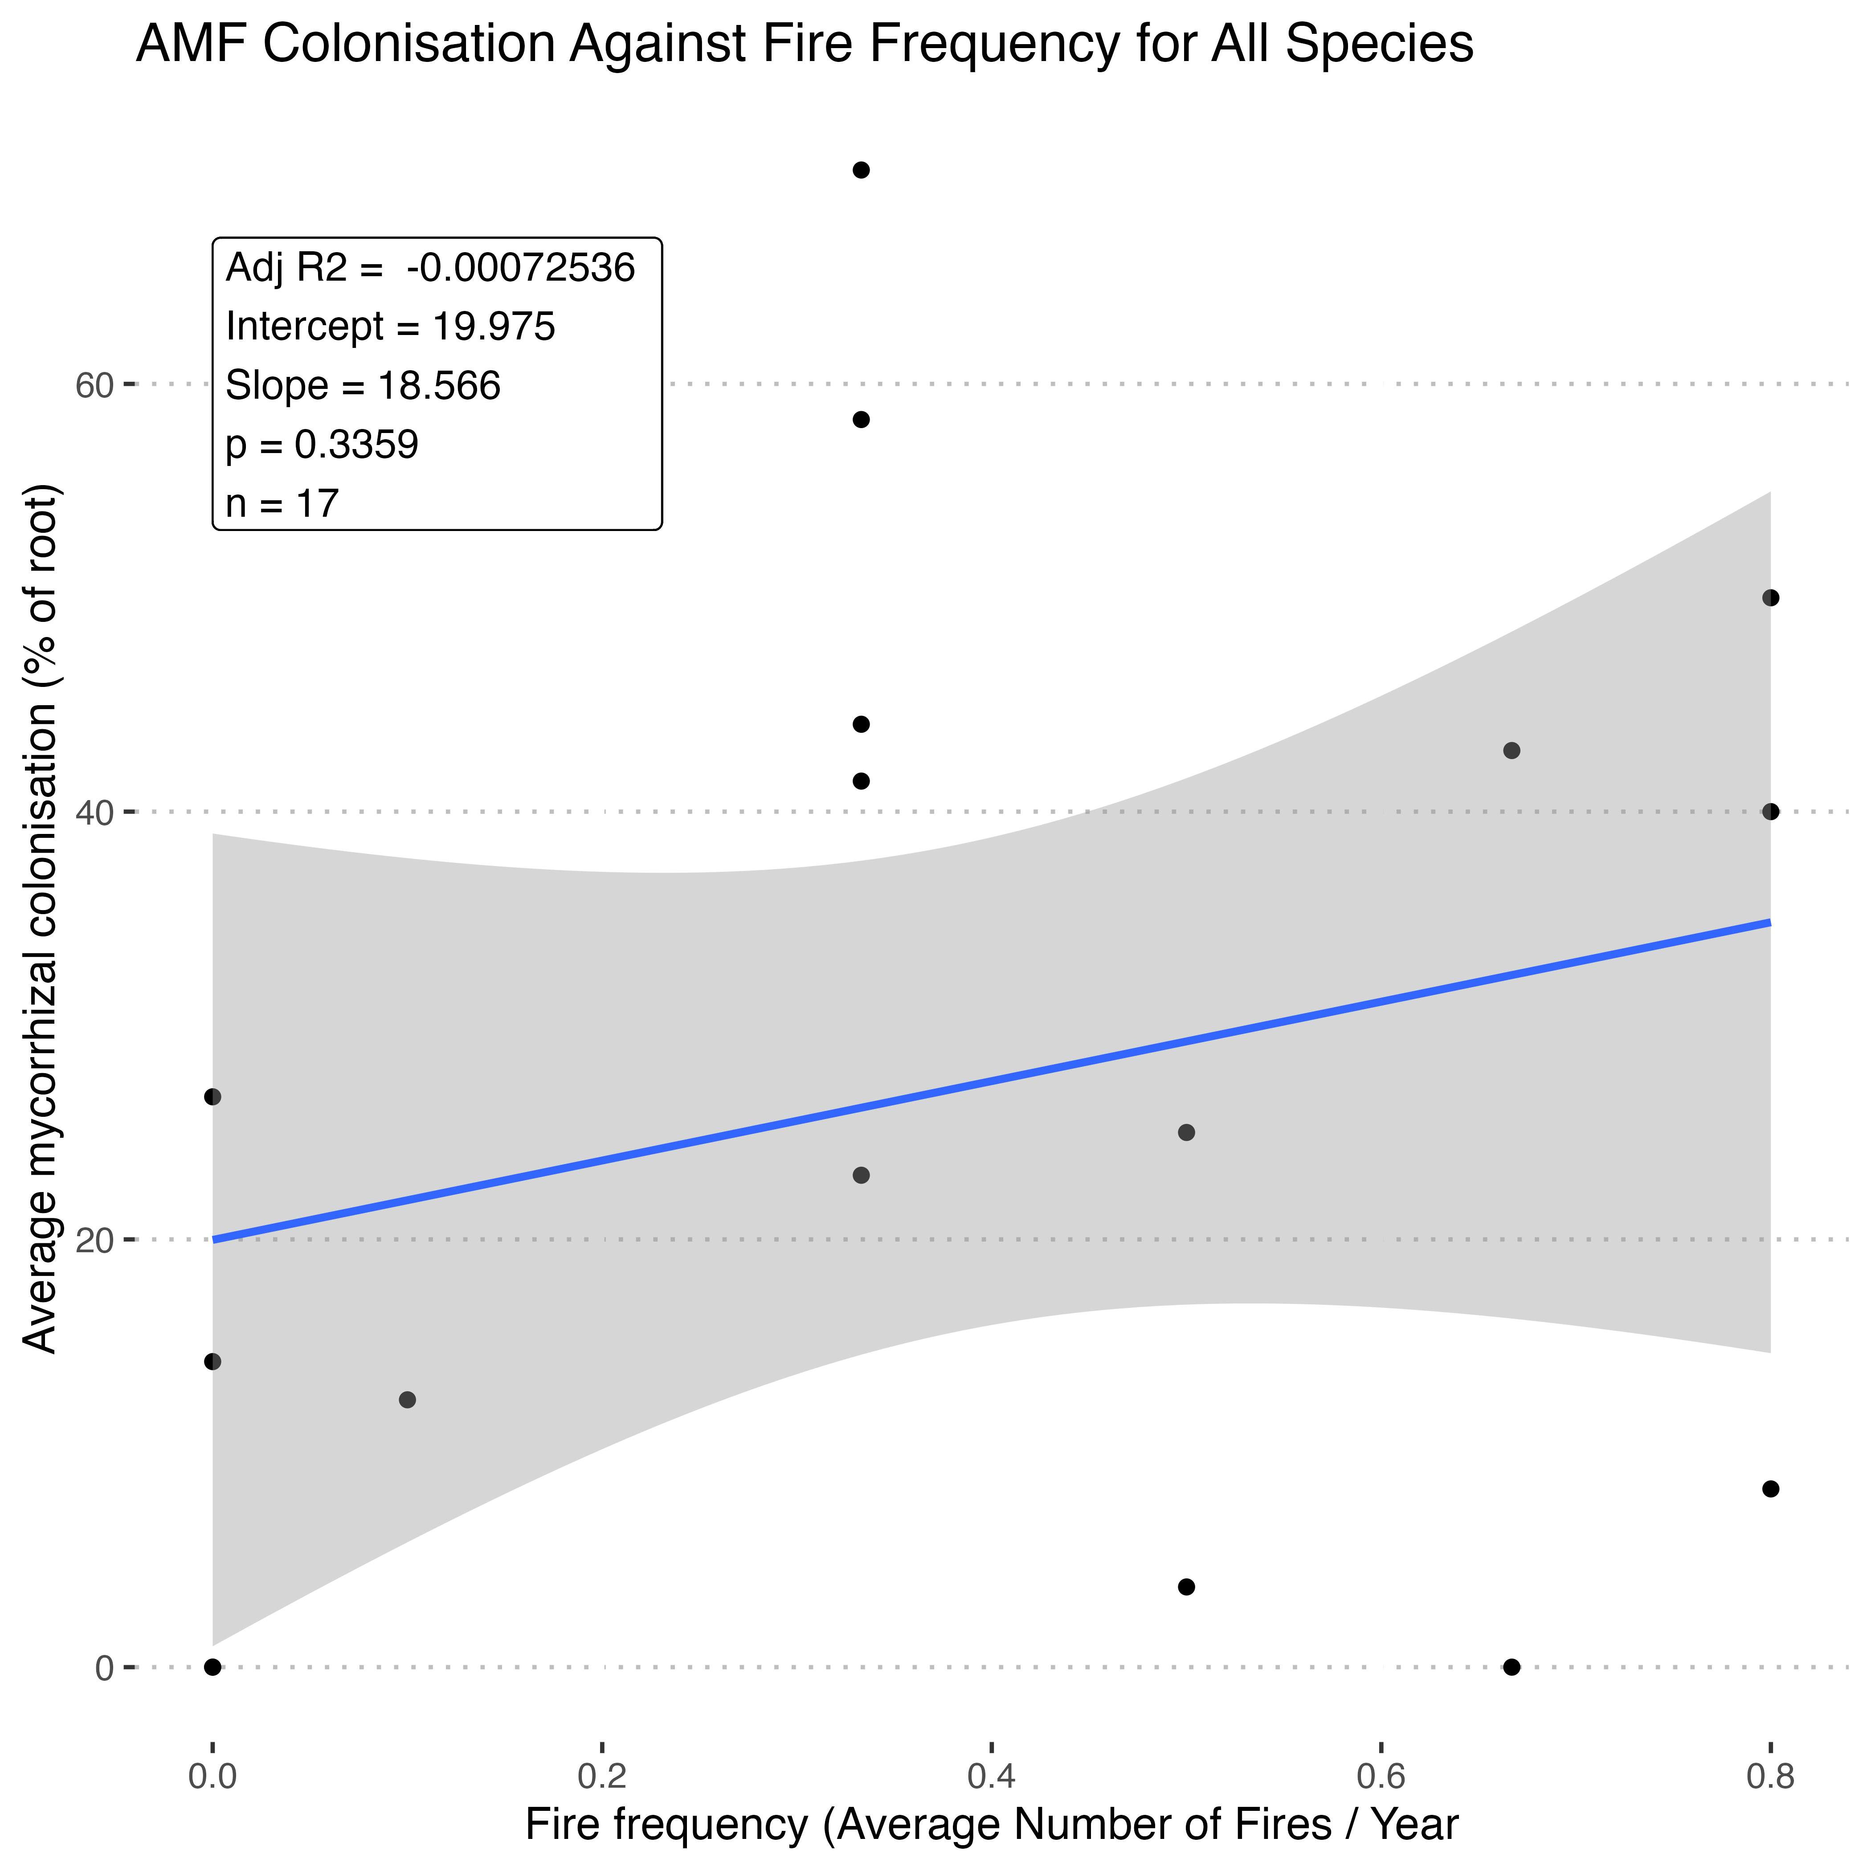
No observable relationship when all species considered

Slide 20
But positive within grasses

Slide 21
and positive relationship in both species with enough samples

Slide 22
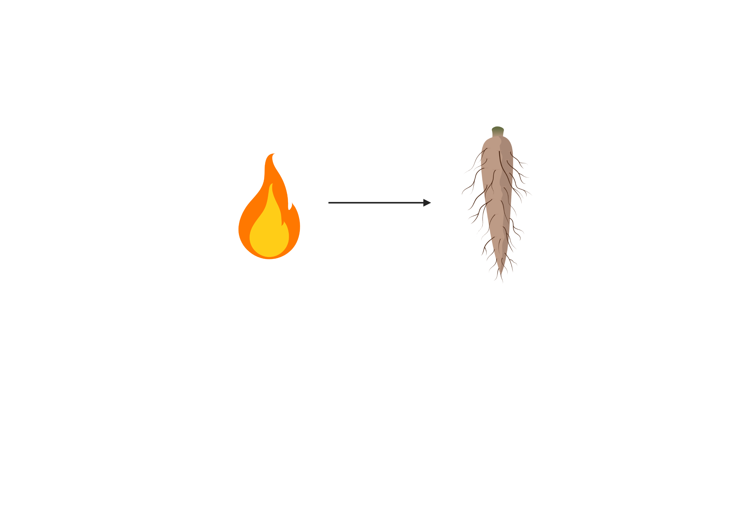
No significant correlation between root diameter and fire frequency

Slide 23
Positive relationship between root tissue density and fire frequency
Notes:
Had to square root data as

Slide 24
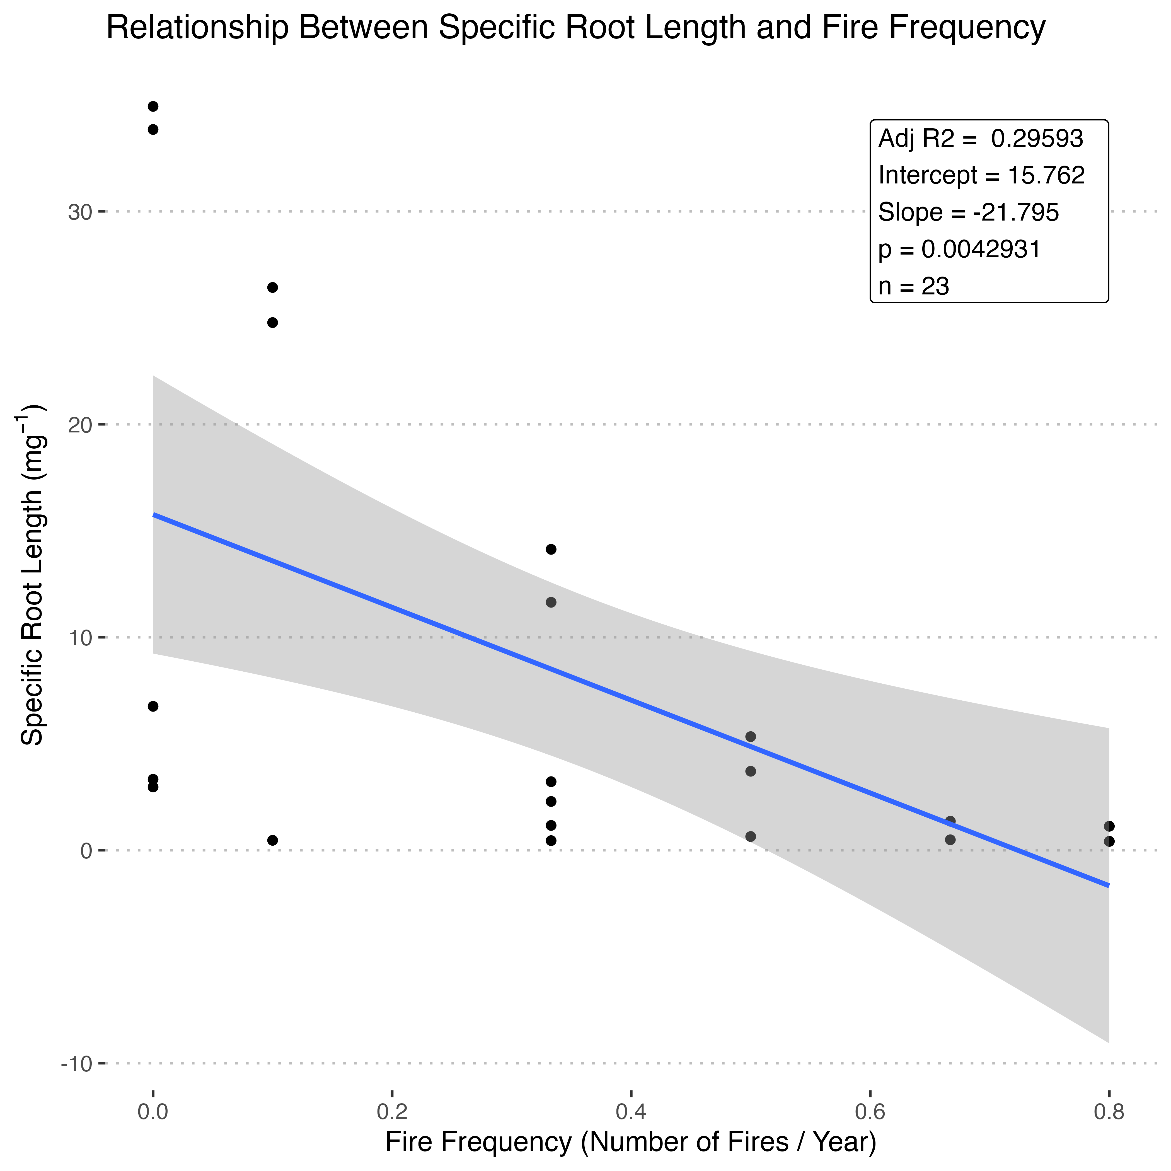
but negative relationship between specific root length and fire frequency (when consider functional groups separately)

Slide 25
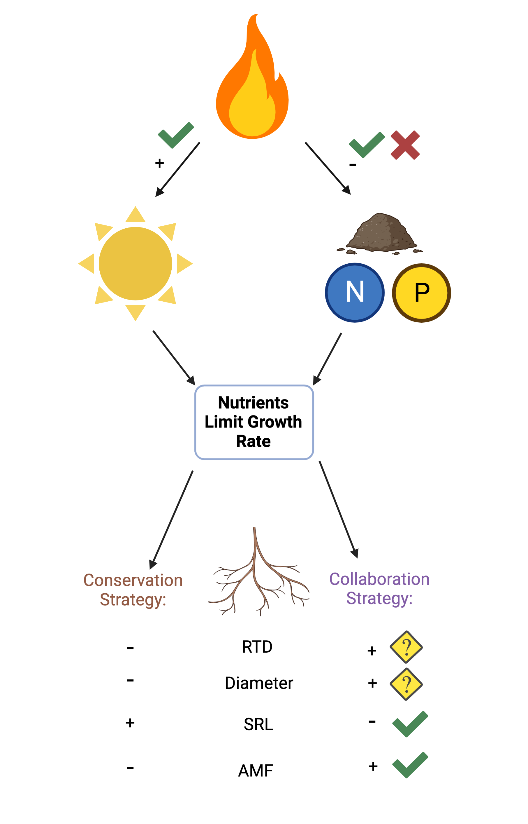
Results Summary

Slide 26
Conclusions

Slide 27
Questions
Is it worth including a wider range of physiological root traits in my analyses?
Is it worth including more soil nutrients that have less relevance to AMF colonisation? (Ca, K e.t.c?)
How should I combat the linear models predicting negative values? Transform the data? Use a non-linear model?
How could I measure the root tissue density and average diameter of the very large tree roots? Is this worthwhile?

